Slide 1
Factors: 1. Straw,
Rotation R3 no straw
Rotation R4 with straw
Tillage,
Ploughing
Tine cultivation H₈₋₁₀
Direct
Cover crops,
Radish 14 days before harvest
Radish just after harvest
Ryegrass + red clover in spring as a ley
Ryegrass + red clover 14 days before harvest

Slide 2
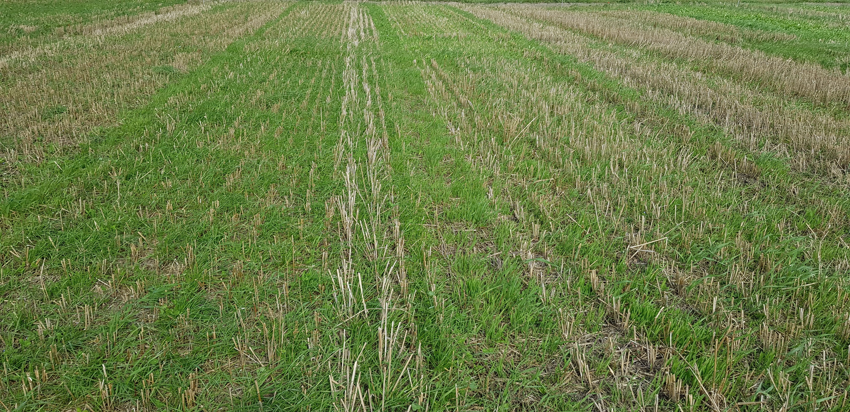
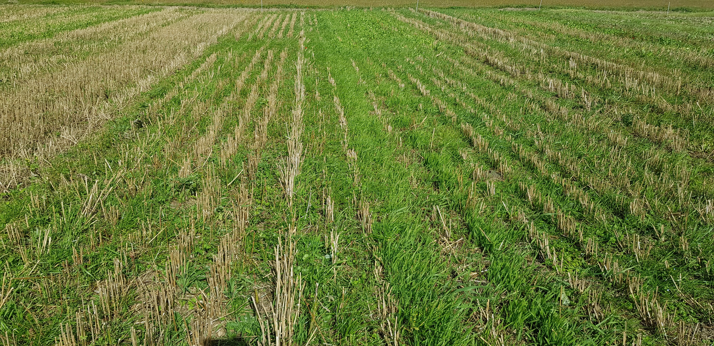

Slide 3
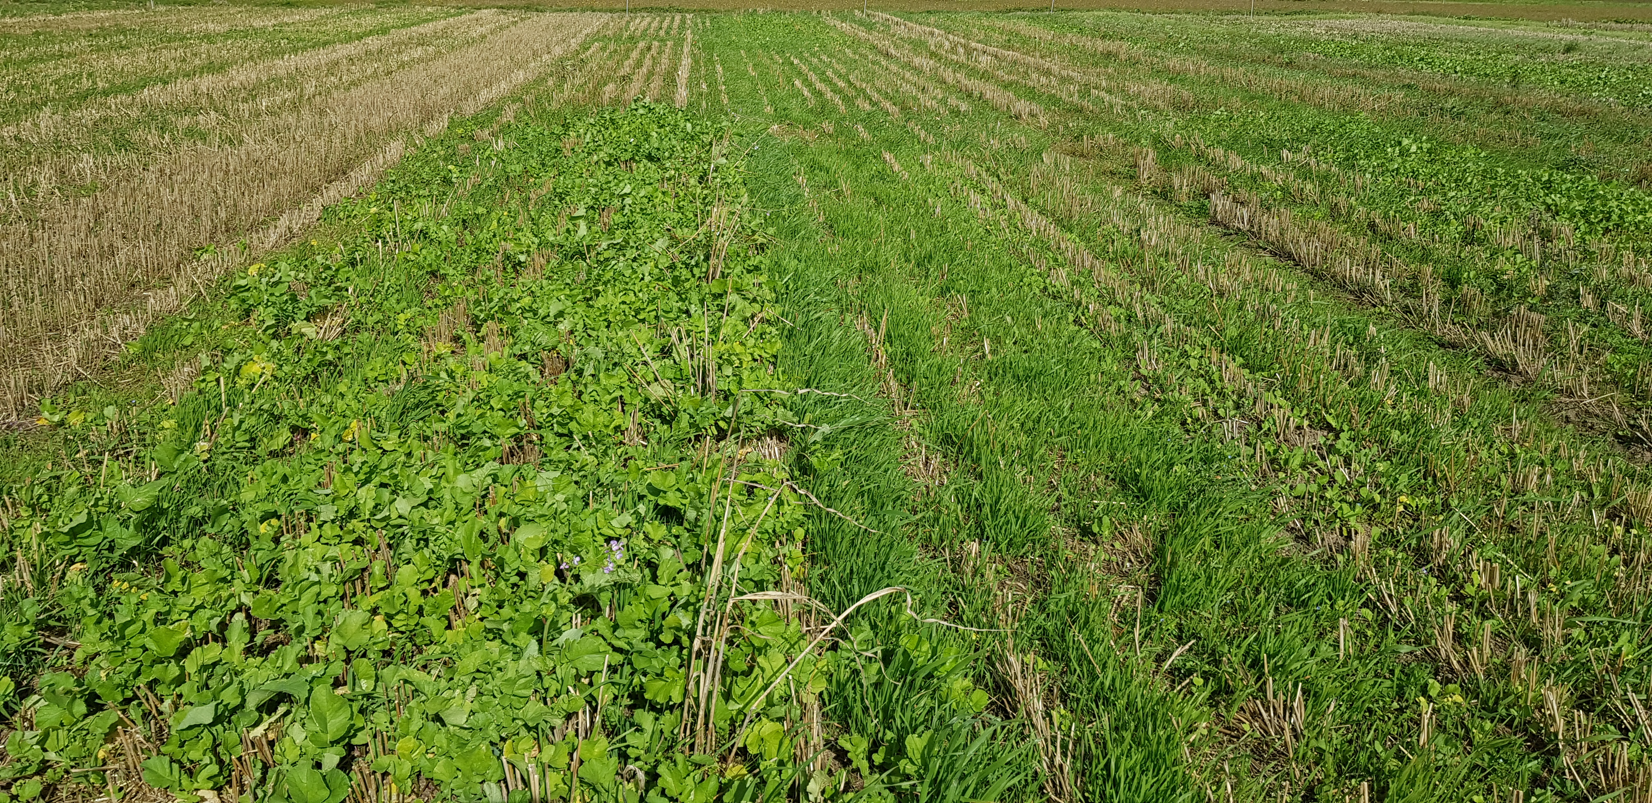
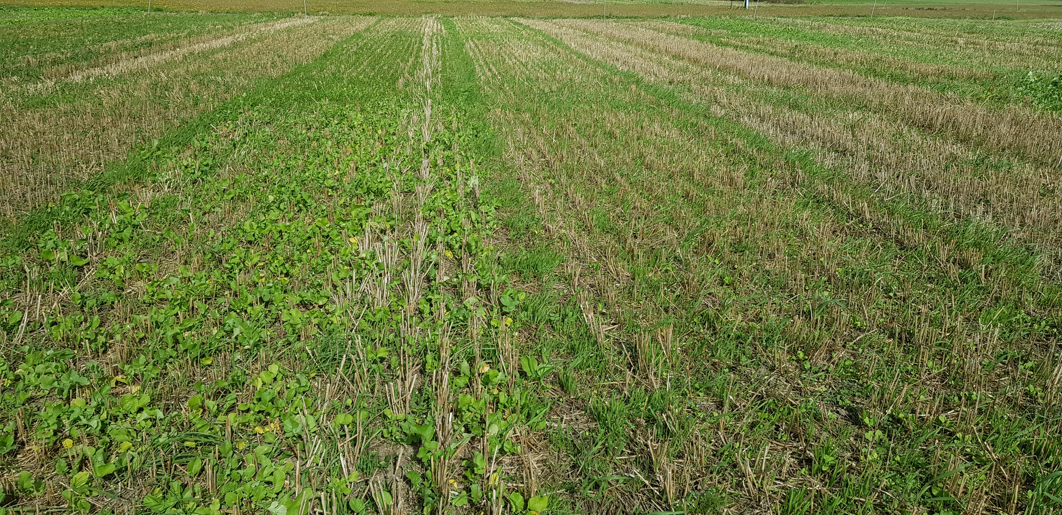

Slide 5
2018

Slide 6
2019

